Slide 1
Fi’s Enrichment Education Support (FEES) Fund In memory of Fiona Braidwood
Registration number 1182839
Lent Lunch - March
Notes:
Thank you for the opportunity to talk today
My Name is Vicki Caldwell I am a trustee of fi’s enrichment education support fund known as fees fund that was set up in memory of my daughter Fiona Braidwood
a very special small charity close to my heart
I would like to say a big thank you for the incredible fund raising effort of the catholic church in Cheddar who chose FEESFund as their charity of the year and hope the talk today helps to tell you more about fees fund why it was set up its charitable purpose and impact fees fund grants have.
I recognise that in telling you about fees fund I am also going to be touching on some very sad themes about a young person who life was cut short following a car accident and this might be triggering for individuals . Please feel free to take time out and seek support if needed. I hope rather than heaviness and sadness my talk today shows that out of such sadness a momentum for good and hope can be build. fees fund shows how it is possible with community support to create a positive legacy that keeps the memory of that person close and very present
I think Fi would approve of this talk today but not as much as her Granny my Mum Josie Caldwell who was a founding and active member of this parish from the 60’s through to the late 90’s and was very committed to church's together and never missed a lent lunch. She saw lent as a time for reflection and encouraged us to do something extra that had impact in the lives of other rather than give something up. I hope this talk today inspires and an example of the power of community and what is possible when we work together and show kindness.

Slide 2
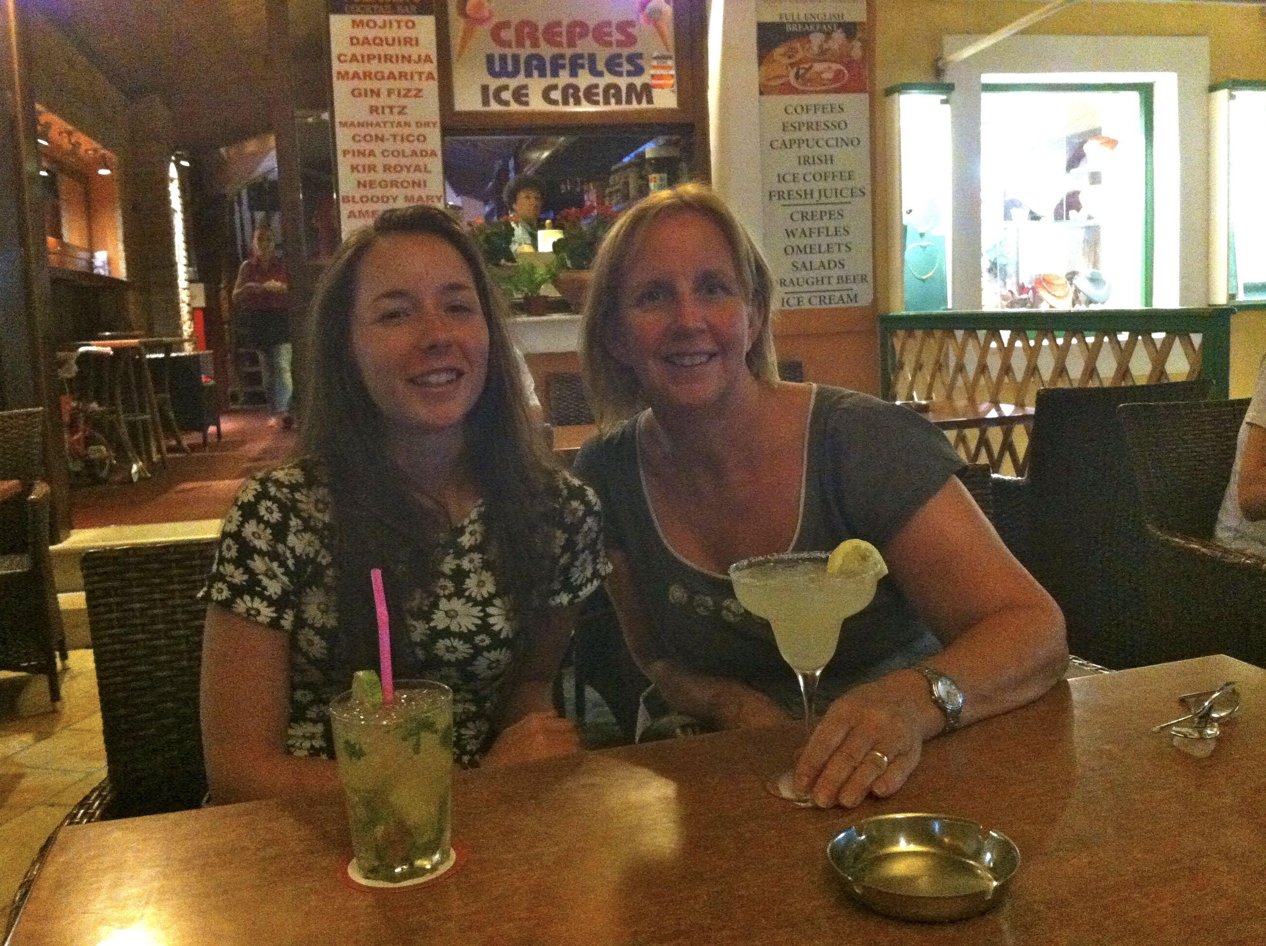
Today
Fi
Building a living legacy
Momentum
Community support
Our grants
Getting involved
The Ripple effect
Notes:
What I want to talk about today …. Fi, Momentum, Community, Our grants, My learnings
Organ donation
Getting involved
This photo was taken on her first day of 6thform. - She was excited to be studying A-levels having gained impressive GCSE results – all at A and A*level

Slide 3
Lovely Fi
Notes:
I want to introduce you to Fi my daughter and middle child as she inspired FEESFund
she was amazing, beautiful, clever, talented in so many ways.
She was full of energy and very sparky.
You knew she was present such a strong personality. It was like she knew life was short….
This photo was taken by one of close friends. She was so happy at 6thform. - She was excited to be studying A-levels having gained impressive GCSE results – all at A and A*level
Fi was academically bright - she loved learning., she loved engaging with new ideas and gaining fresh perspectives. She had ambitions after University to work in Government and help shape public policy

Slide 4
Character, values and principles
A strong moral compass and could be uncompromising
Standing up for her values and principles: things she believed in
Fi wanted to make the world a better place
It sometimes feels like she has handed over an important baton….
Notes:
It feels important to tell you a bit more about Fi:- her character, qualities, & principles. As this shaped our organ donation experiences
Fi had a strong value base and moral compass grounded on principles of social justice and equality.
She was a keen user of social media and followed the caused she felt passionately about. She could be uncompromising if she felt that things were unfair,
This slide shows quotes taken from her bedroom wall which I think helped to remind her
that you needed to stand up for things that you believed in. Even if it was hard and makes your voice shake.
We can all make a difference and that we shouldn’t leave it to others.
Fi wanted her life to matter and to live a life worth writing about.
It sometimes feels Fi handed over an important baton to her family and friends and the people she continues to touch after her death.
Fi Inspiring others is an important theme I will return too towards the end of this presentation.

Slide 5
Memories of Fi – shared by her friends
'Fi never stopped smiling. whether she was cutting up pizza with scissors after a night out or taking lit disposables, her iconic character shines through every memory’
‘In her room there is a sign asking, ‘what do you want to be when you’re older?’.. the reply is ‘happy.’ and she was, she really was’
'Her strength of character and independence is obvious in everything she does. Her determination to live life to the full and make the most of every moment is amazing; In this way Fi is truly iconic’
Notes:
Memories from Fi’s friends shared at her funeral
Parents always think their children are incredible and special, In this slide I have share memories from Fi’s friends shared at her funeral which I also think also provide insights into her personality, her quirks and the ways she was respected by her peers
In her room there is a sign asking ‘what do you want to be when you’re older? ’. the reply is ‘happy.’ and she was, she really was‘’
Fi never stopped smiling. ‘whether she was cutting up pizza with scissors after a night out or taking lit disposables, her iconic character shines through every memory.
''Her strength of character and independence is obvious in everything she does. Her determination to live life to the full and make the most of every moment is amazing; In this way Fi is truly iconic.
Her tutor wrote on her last school report
‘when you are prime minister Fi, running the county please don’t forget hard working teachers who are due a pay rise’’

Slide 6
March 2016 unexpected, traumatic death
Fi was involved in a car accident and was air lifted to hospital
The assessment in A&E confirmed devastating injuries
The news that her head injury was not survivable was shared immediately
Fi was transferred to ICU and we were given space to process what we were being told. We spend a very precious day and night with Fi watching her life slip away
Notes:
So, what happened? The headlines are
Fi was involved in a car accident in which she sustained a serious head injury
She was treated at the scene and then air lifted to the regional neuro trauma centre We are so grateful to the emergency services and medics that treated Fi at the roadside. Their decision to airlift her to hospital meant we could spend time with Fi at the end of her life and be together.
The assessment in A& E confirmed devastating brain injuries.
The news that Fi’s head injury was not survivable was shared immediately when we arrived at the hospital with kindness and compassion.
Fi was transferred to ICU
We were given time and space to process what we were being told. This time although probably less than 12 hours didn’t feel rushed.
We spend a very precious day and night with Fi watching her life slip away.

Slide 7
A bright future cut short
Fi died at Southmead Hospital on 30 March 2016
So many people were affected
A momentum for something positive to come out of such sadness
A living legacy
built out of kindness and a strong sense of community
Notes:
Fi put her name on the organ donor register and had made us aware of these end of life wishes.
As parents we were having conversations about an organ donation decision much earlier in the day
It wasn’t a shock nor was it hard when we were approached and asked to consent to organ donation.
Saying yes to organ donation was the only easy thing that happened on that truly dreadful day.
We were guided through the process by the most incredible specialist nurse. This combined with the kindness, support, compassion and professionalism by the whole team working with Fi in ICU
It felt like a beacon of hope on that saddest day.
Following Fi’s wishes would mean other lives could be saved this was something the whole family got behind
As a multiple organ donor, with the skills of the medical and transplant teams, Fi donation went onto to save the lives of four people.
What an incredible legacy something we continue to be immensely proud
A momentum built from the uniting power of grief.
As a community, we sought to build a legacy out of tragedy and keep memory of Fi alive in the most impactful ways possible.
Fi left this world far too early, but her spirit lives on through the charitable efforts of ‘FEESfund’, which awards grants to support young people enrich their education and pursue their ambitions.
The creation of this fund was a real turning point for our shared grief – creating hope in the darkest days and something that was fitting for Fi who loved learning and herself n=benefited from community based enrichment activities

Slide 8
Not always an angel or finding life easy
Notes:
Fi wasn’t always a confident self-assured young woman she became at 6th form.
In her early teen she experienced challenging friendships, she was self conscious and lacking in confidence. She was worried that she wasn’t liked and her lack of being ‘ popular worried her and created self doubt. She worried constantly what her peers thought of her and held her back from being seen to do well at school. She stopped doing things that she loved or felt passionately about because of a worry it would be considered uncool and not the thing to be seen doing. Parents evening had a theme that Fi could do well but was coasting and not achieving her academic potential
So what was it that changed this?

Slide 9
Ten Tors Challenge - a turning point just before Fi’s 14th Birthday
Notes:
Completing the ten tors challenges as a scout was I believe a turning point in Fi’s life where she chosen to grab every opportunity life gave her, use all her talents and abilities to follow her dreams and reach her potential in all areas of her left.
Completing this grueling 35 mile challenge as the only girl in a team of 6 just before her 14th birthday helped her to recognize that when you move out of your comfort zone and challenge your self you grow as an individual in some many ways. Fi thought anything was possible after this

Slide 10
Braidwood Day
A week before Fi died, Fi’s chemistry teacher named the 18th March as Braidwood Day.
A year after Fi died friends and family gathered to walk on Dartmoor a special way to mark ‘Braidwood Day’

Slide 11
Momentum
Notes:
Research shows there are many benefits for children and young people who take part in extracurricular activities. Such activities can result in improved education outcomes, the building of social and emotional skills and improved social inclusion particularly when children from disadvantaged backgrounds take part. Enrichment activities don’t come cheap. Lots of families in this cost of living crisis are finding it increasingly hard to stretch family budgets for extra curricula activities and can make learning such fun

Slide 12
… and then FEES Fund
An enrichment education support fund that would remove financial barriers so Children and Young people could take part in extracurricular activities that would help support a love of learning
Opportunity
Aspiration
Kindness
Community

Slide 13
Community

Slide 14
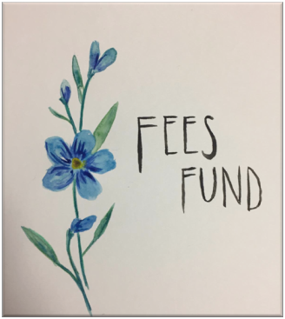
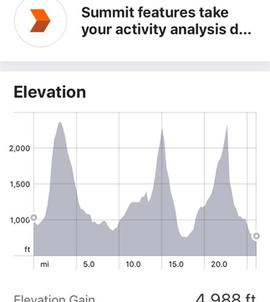
First fundraiser
The Yorkshire Three Peaks challenge in May 2019 helping to launch FEES Fund and its charitable status

Slide 15
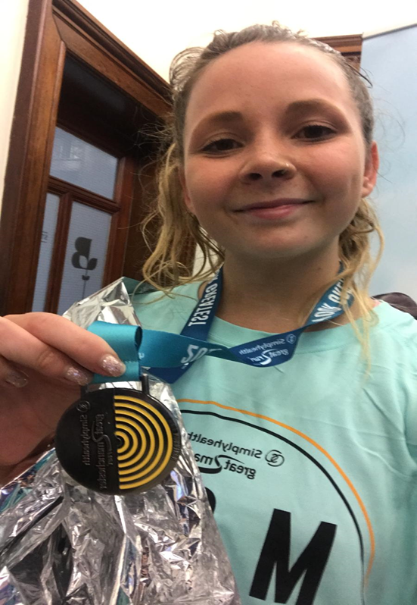
Fundraising begins …
Fi’s birthday weekend
Manchester Half Marathon
15 runners thinking of Fi
Over £2500 raised
Notes:
FEES Fund Launch in 2019
Recipients encouraged to share their stories though the FEES Fund website to support future fundraising and grant applications. Fundraising events include:-
Cycle ride to Holland
Dartmoor Ten Tors challenge by Fi’s family and friends
Banwell Football club fun day
Manchester Half Marathon 2018
Bristol Half Marathon 2018
Ongoing kind and generous donations from family, friends and the community

Slide 16
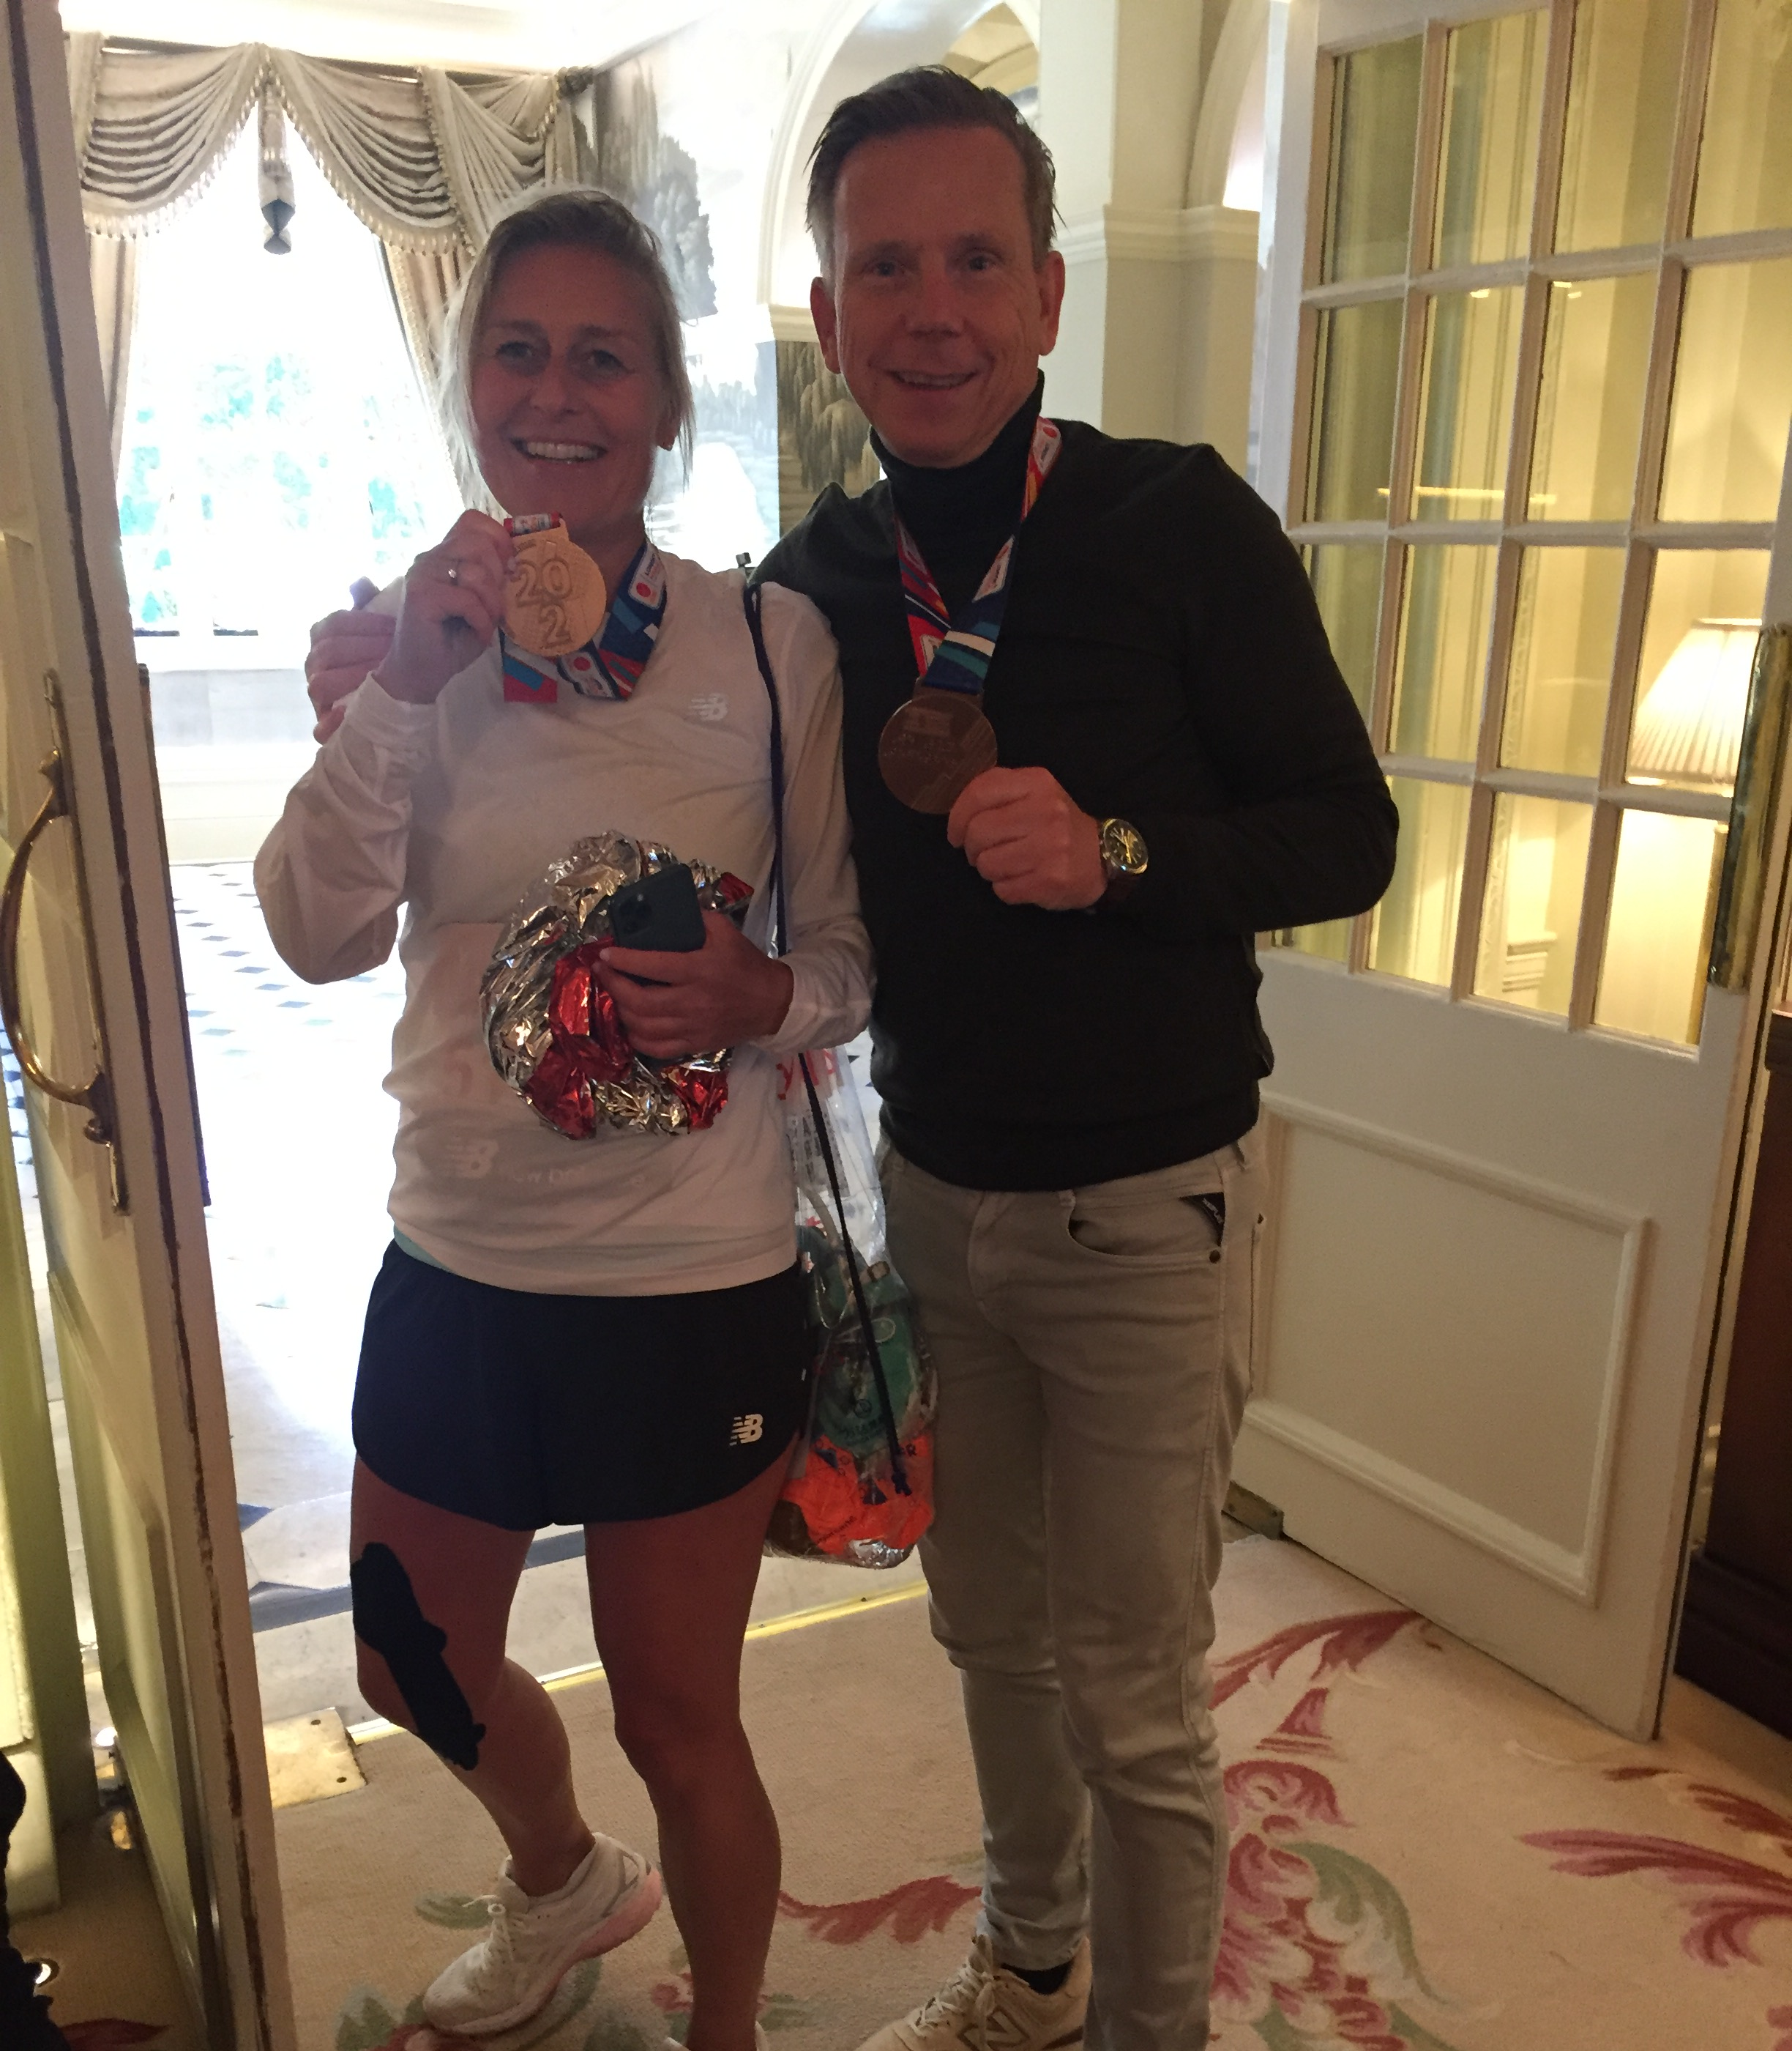
Fundraisers
Runners
5K, 10K, Half & Full Marathon
Cyclists
Swimmers
Walkers
26.2 challenge

Slide 17
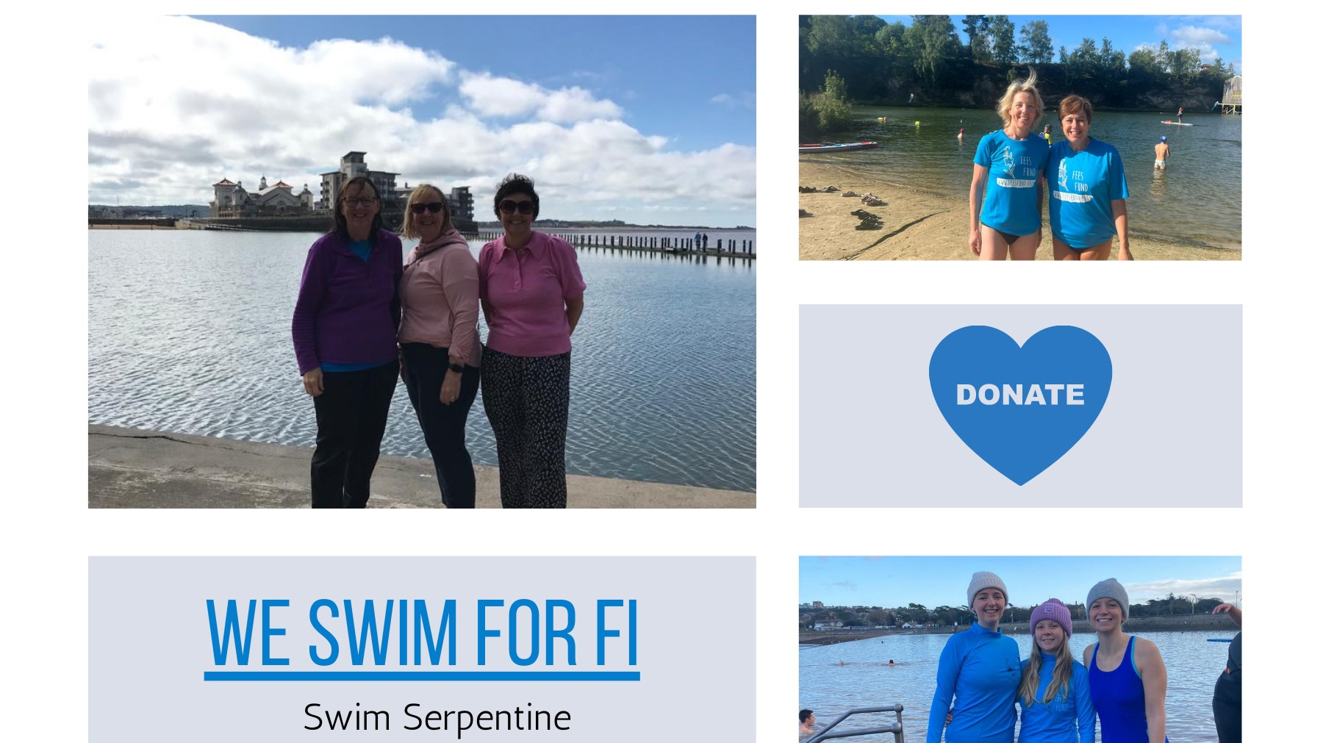

Slide 18
Notes:
It feels very special that FEES Fund grants have been made possible as a result of community support and wanting to spread kindness when life is tough. fees fund grants create opportunities that wouldn’t have been possible and in doing so are helping to raise aspirations.
FEESFund grants have funded music lessons, scouting and guiding activities, outdoor adventures, gardening clubs, maths clubs, gym competitions, swimming lessons, school trips, mountain biking, golf lessons, drumming lessons, football and swim camps, musical theatre, iceskating and horse riding.
FEES Fund grants are available for children and young people aged between 7- 25 to take part in enrichment education support activities. FEES Fund grants aim to address the financial barriers that can exist when family finances are tight
Golf feedback
Dear Fees Fund,In this report, we have written as his parents, David has written, and AJ, his coach has written a report.
As parents, want to thank you for the opportunity you gave our son, to find a sport talent he had hidden away inside him.
Due to his ADHD, he has struggled to find something that he excels at and that motivates him.
These golf lessons over the last few months have completely turned him around. There was a time he didn’t want to leave his room.
From the first lesson, AJ was able to engage him in learning golf and to believe in himself. XXXX always looked forward to his lessons.
After a few lessons, he started gaining confidence. He even suggested having lessons before school, because it would motivate him to get up and go to the lesson, then he would go to school with a better and more confident attitude.
Doing these golf lessons has given XXX dreams to play golf professionally in the future. He has met many wonderful people at the golf course, they have also encouraged him to play and think about going to a golf academy while continuing his education. AJ has been like a mentor and has carefully invested time and technique into his skills advancement and character.
All of this happened due to these sponsored lessons. We are sad to see them end. We would like to be considered for a further scholarship of more lessons to continue his progress.
We have invested in golf clubs for him and a golf membership at a club nearby, so he can continue to practice. Having more lessons would help him continue on the path he’s started, and help us keep him going forward.
In conclusion, we thank you for the foresight of such a fund that can make such an impact on children with special needs, we remain very grateful,
Provider
was asked to coach David over 10/12 sessions on the aspects of the game. I'm the Senior PGA Professional at Tickenham Golf Centre • David has a great love for this game & we bonded on a golf level & a personal level • We worked hard on his Stance Posture & balance Slowing down his backswing but most of all reducing his swing as it was way to long and out of control David demonstrated these throughout the course of sessions •We spent time on the course working on his short game and course management In my professional opinion I believe that David excelled in these areas but as we all know Golf is a very difficult game and I honestly believe he would benefit from more 1-2-1 coaching • He is a lovely young man and a credit to his family If you require any other information please do not hesitate in contacting myself
From the Young person
hank you for my golf lessons.
Golf lessons have helped me in a way to get me on a path to get into my dream college program. I have the goal to go to SGS college and join the golf academy. The current required handicap to get into this course is 10 and my current handicap is 17. AJ has been a great instructor and mentor for me in golf. I believe, with more lessons he could help me achieve this goal, and my dream of joining the golf academy.
I hope you will consider continuing my lessons with AJ to make this possible. It has helped me in many ways. In exercise and in school too.
Thank you very much,
Applying for a FEESFund grant
If you know children / young people who would benefit from a FEESFund grant please discuss this with them and their family and make an application on the website. There is more information on how to apply, check the eligibility criteria and the FAQ’s section. The checklist is also a helpful tool before making an application helping you to complete the online form
FEES Fund grants are usually around £200- £400 each
FEES Fund pay grants directly to enrichment activities providers.
All applications do require the support of a sponsor or an advocate who can provide a brief supporting statement around the envisaged outcome / benefits that will be gained by the child / young person in taking part in the extracurricular activity. Stronger applications are completed with the child and young persons involvement.
On the application form sponsors / advocates are asked to confirm where the activity will take place, the cost of the activity and a contact person in the organisation for FEES Fund trustees to liaise with around the payment of the grant.
After the activity has taken place the sponsor / advocate are asked to share a brief impact report to ensure fees fund continue to meet its charitable purpose

Slide 19
How?
Our website www.feesfund.org
Fundraising, sharing our posts, applying for a fund, telling people about us, encouraging others to apply – anything and any ideas you have we would love to hear from you
Notes:
Help with fundraising and promoting FEES Fund on social media (Website: feesfund.org or keep in touch by following FEES Fund on Instagram
Make an application to FEES Fund and then share your story to encourage future applications
Make an application on behalf of someone you have noticed might need unexpected kindness to be able to follow a dream. ( NB please let them know and seek their permission before making an application)
Are you part of an organisation that provides community activities? Do you know children / Young people that would benefit from a fees fund grant
Help to promote FEES Fund in the community groups you are involved with and encourage Applications to the fund.

Slide 21
Thank you
Vicki Caldwell
www.feesfund.org
Vicki@feesfund.org

